Slide 1
Sprint one delivery
Name: Saeed Ba Wazir

Slide 2
Agenda
Sprint goal
Sprint achievements
The backlog
The documentation
CI/CD
Next sprint planning

Slide 3
Sprint goal
The goals of this sprint are designing the application, and setting up the application skeleton.

Slide 4
Sprint achievements
The application skeleton has been built for a messaging broker, and two service, Api gateway and frontend, you can find more in the repository.
For the documentation the first versions of the list the documents below have been written:
Technical design document
Research plan
Project plan
You can find the documentation in the repository.

Slide 5
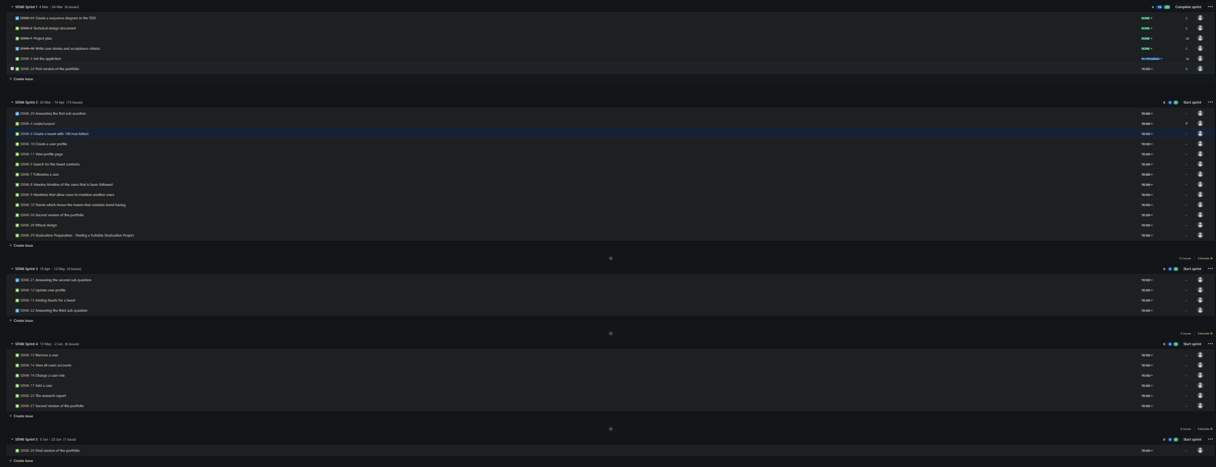
The backlog
For the backlog we are writing the backlog in Jira and below you can find all of the planned user stories per sprint.

Slide 6
The Documentation
The research plan is a document that contains the plan for answering the research questions, and we have written the first version of it and waiting for the feedback.
For the project plan we have written the first version of it.
For the technical design document we have written the first version of it.

Slide 7
CI/CD
The CI/CD pipeline has not been created yet, and we will start with it in the next sprint.

Slide 8
Next sprint planning
Adding CI/CD
Adding more user stories into the application
Answering a sub-question of the research.

